Slide 1
The Angiosperm Life Cycle
Page 75, Judd & Campbell
& Angiosperm Synapomorphies

Slide 2
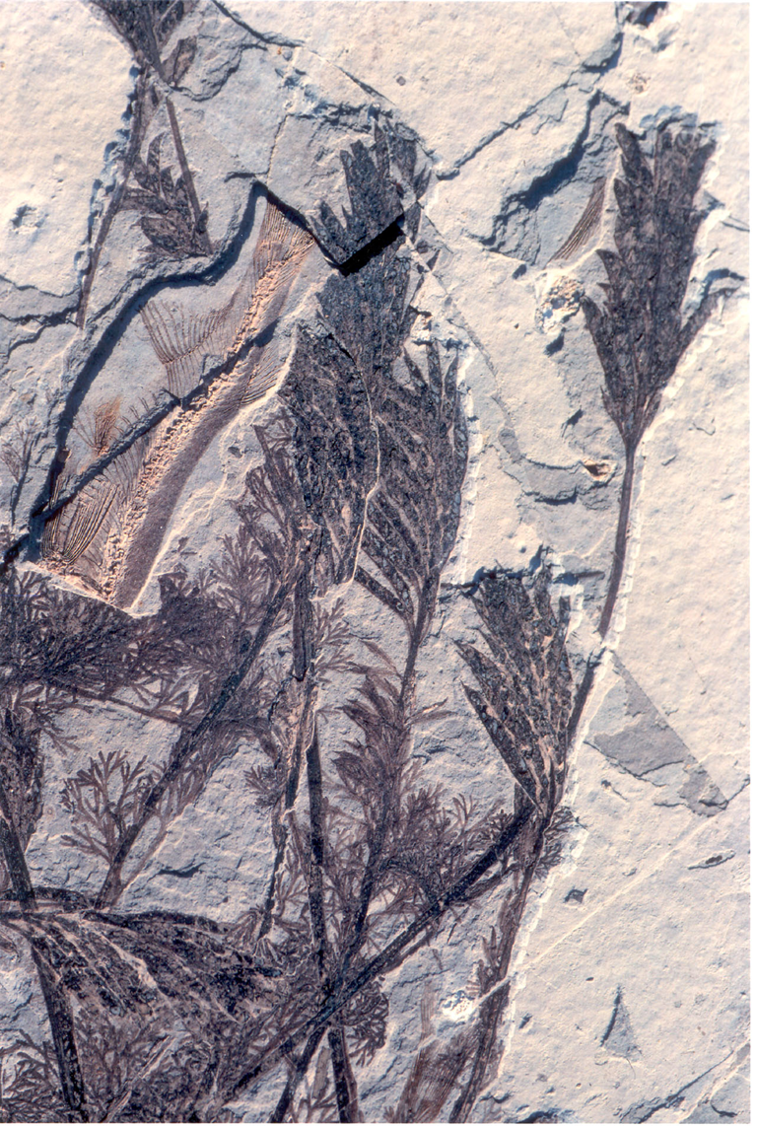
Archaefructus fossil

Slide 3
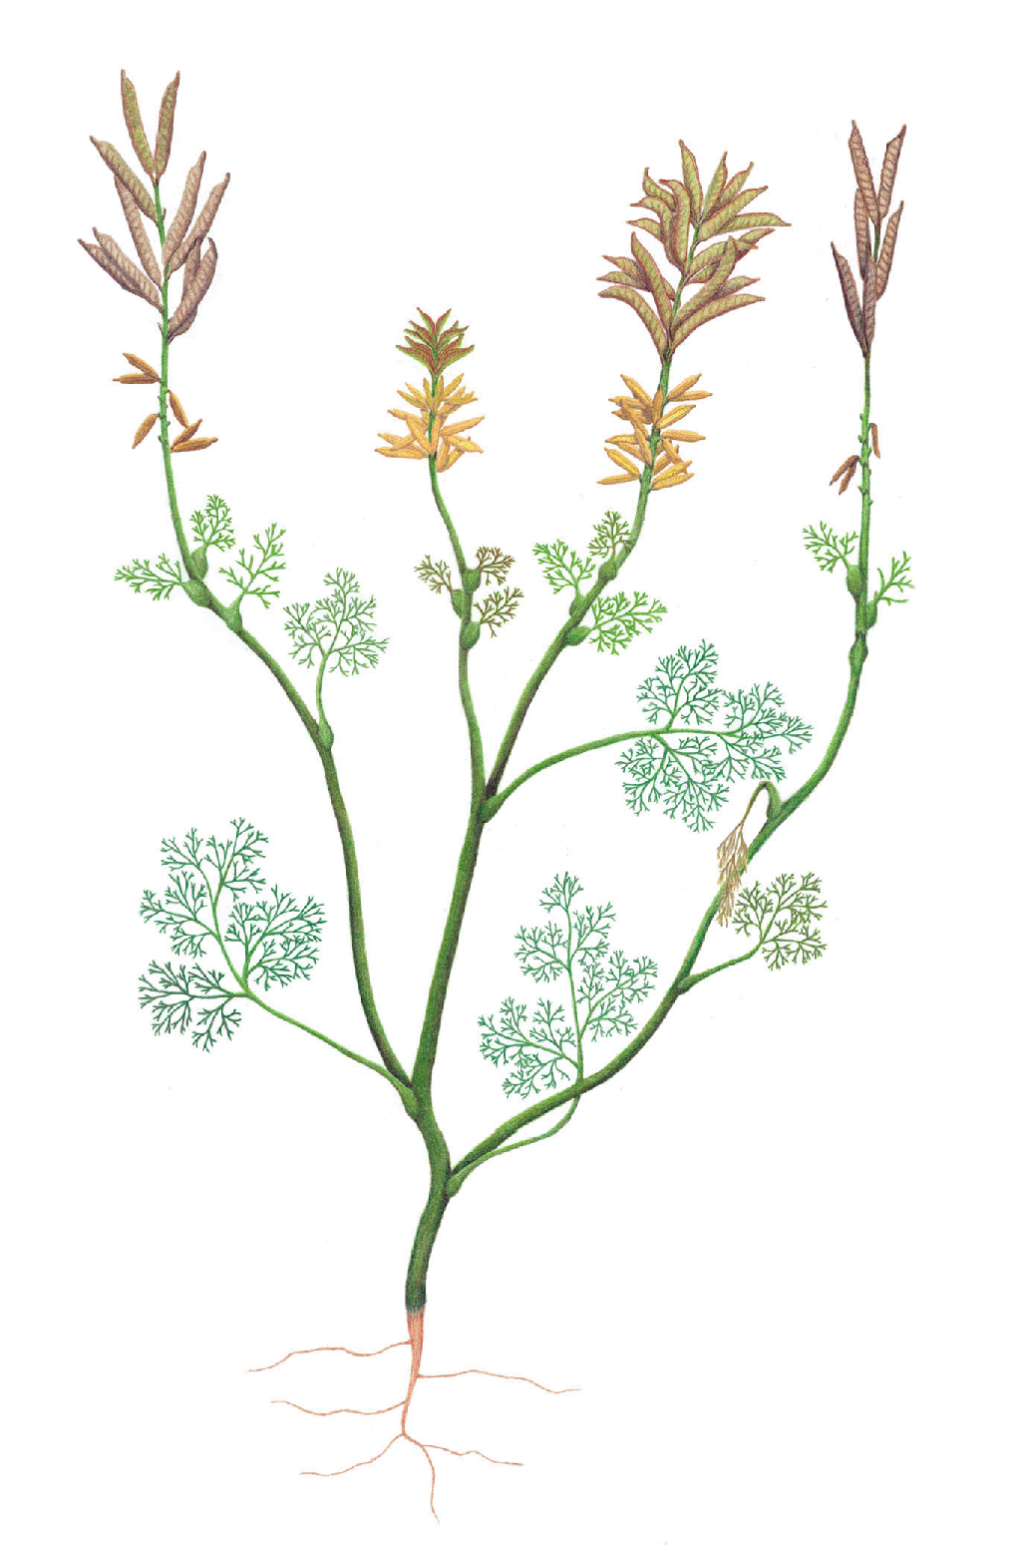
Archaefructus Reconstruction
“It lacks sepals and petals and its reproductive organs, interpreted as carpels and stamens, are produced on an elongate stem”
One of the earliest known genera of flowering plants
“Archaefructus is an extinct genus of herbaceous aquatic seed plants with 3 known species”

Slide 4
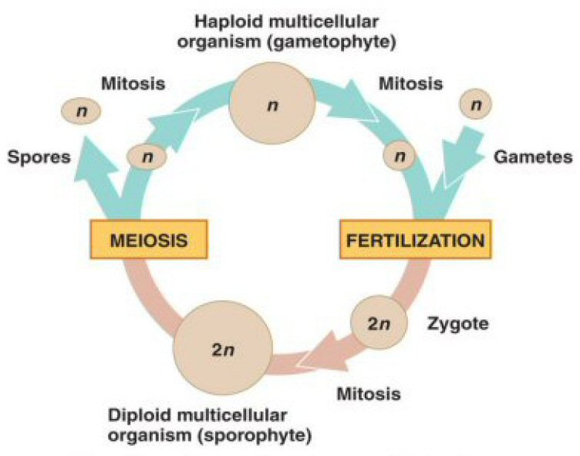
Alternation of Generations
What process gives rise to gametes in plants? What about in animals??
In an alternation of generations, “a diploid sporophyte generation gives rise to a haploid gametophyte generation.” -- Raven et al, Biology.

Slide 5
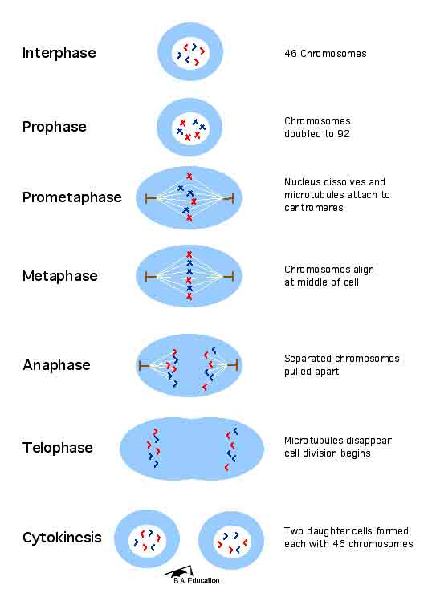
Mitosis
In mitosis, a mother cell of any ploidy count produces 2 daughter cells of the same ploidy count as the mother cell.

Slide 6
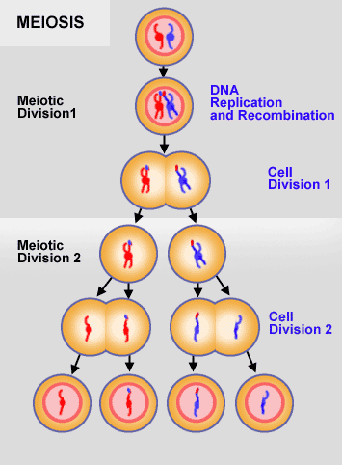
Meiosis
In meiosis, a diploid mother cell produces 4 haploid daughter cells

Slide 7
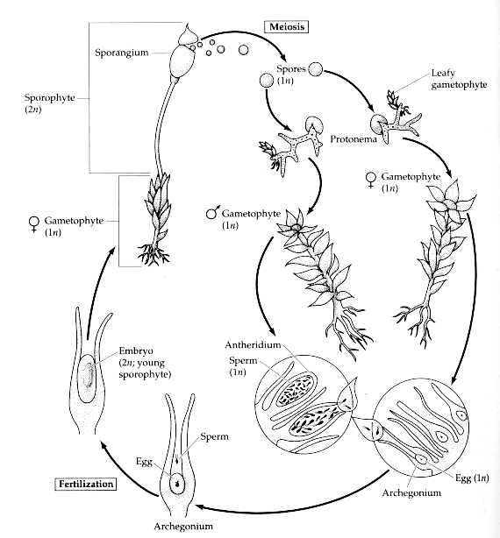
Moss (not angiosperm) Life Cycle
Sporophyte is
completely dependent on Gametophyte

Slide 8
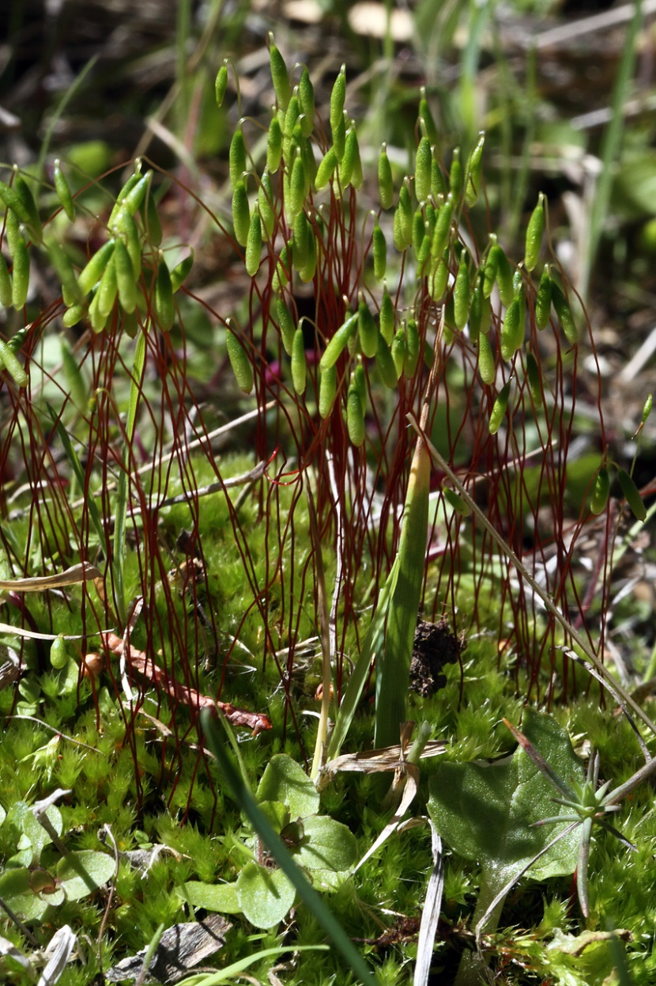
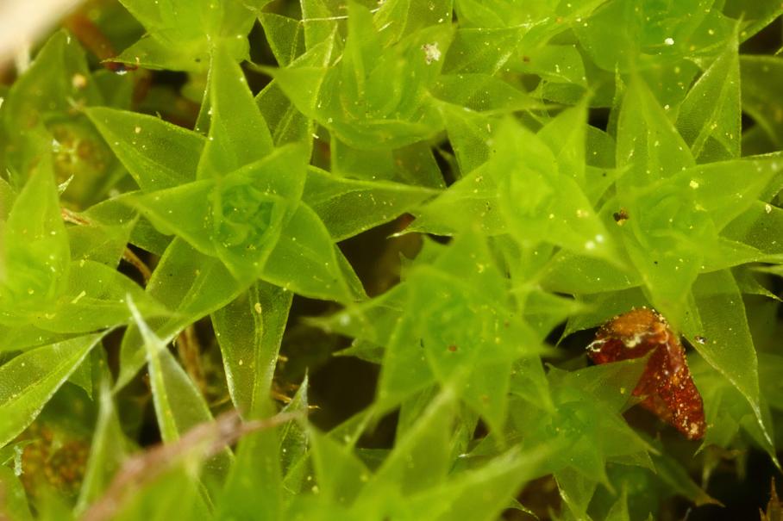
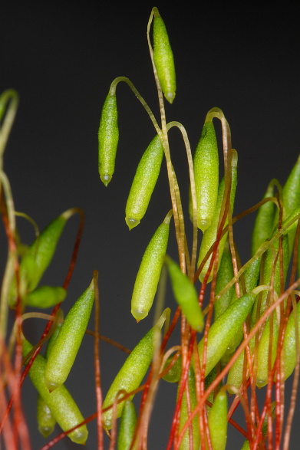
Ptychostomum pseudotriquetrum
Dominant haploid gametophyte generation
Diploid sporophyte completely dependent on gametophyte

Slide 9
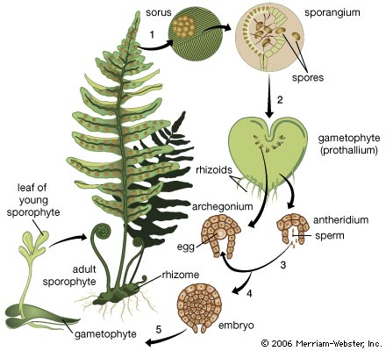
Fern (not angiosperm) Life Cycle
Reduction of gametophyte…
Sporophyte now independent of gametophyte.
Gametophyte still persists as free living individual for months to years.

Slide 10
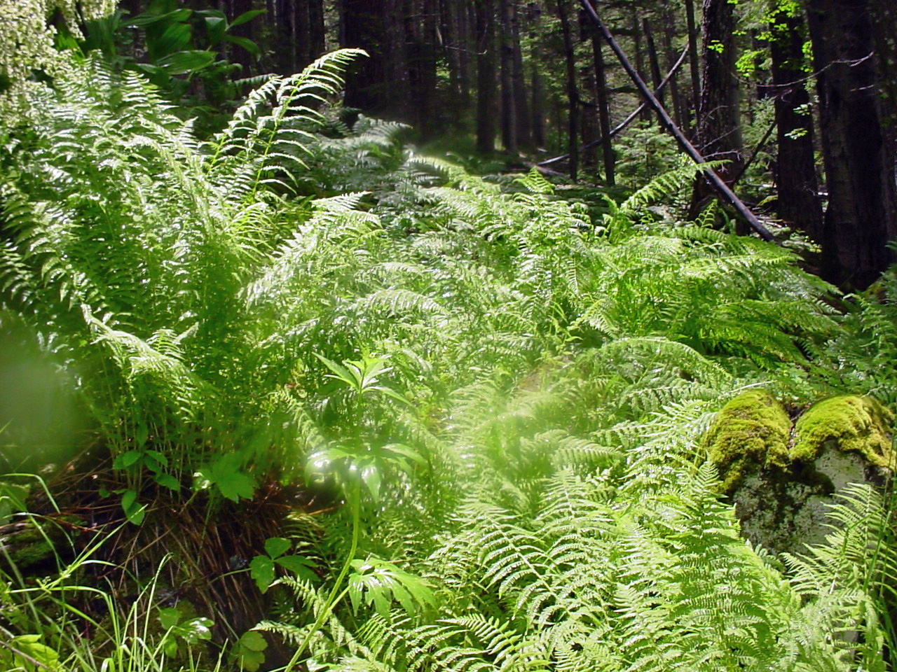
Athyrium felix-femina
Unlike in mosses, what you see here is the sporophyte generation.

Slide 11
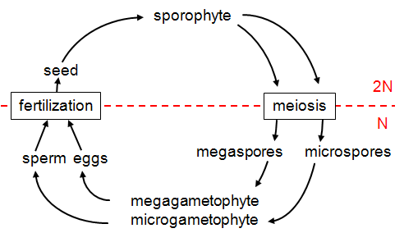
Angiosperm Life Cyle
Diploid
microsporocyte and
megasporocyte
(mother cells of the microspores and megaspores)
Mitosis
Haploid
Mitosis to form vegetative and generative cells
Mitosis
(inside pollen)

Slide 12
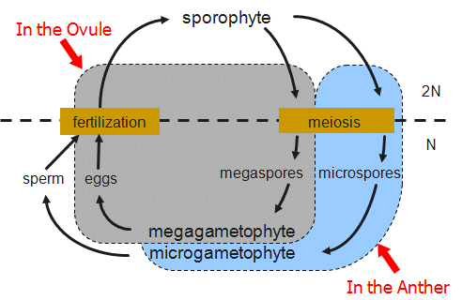
Angiosperm Life Cycle
Next slide

Slide 13
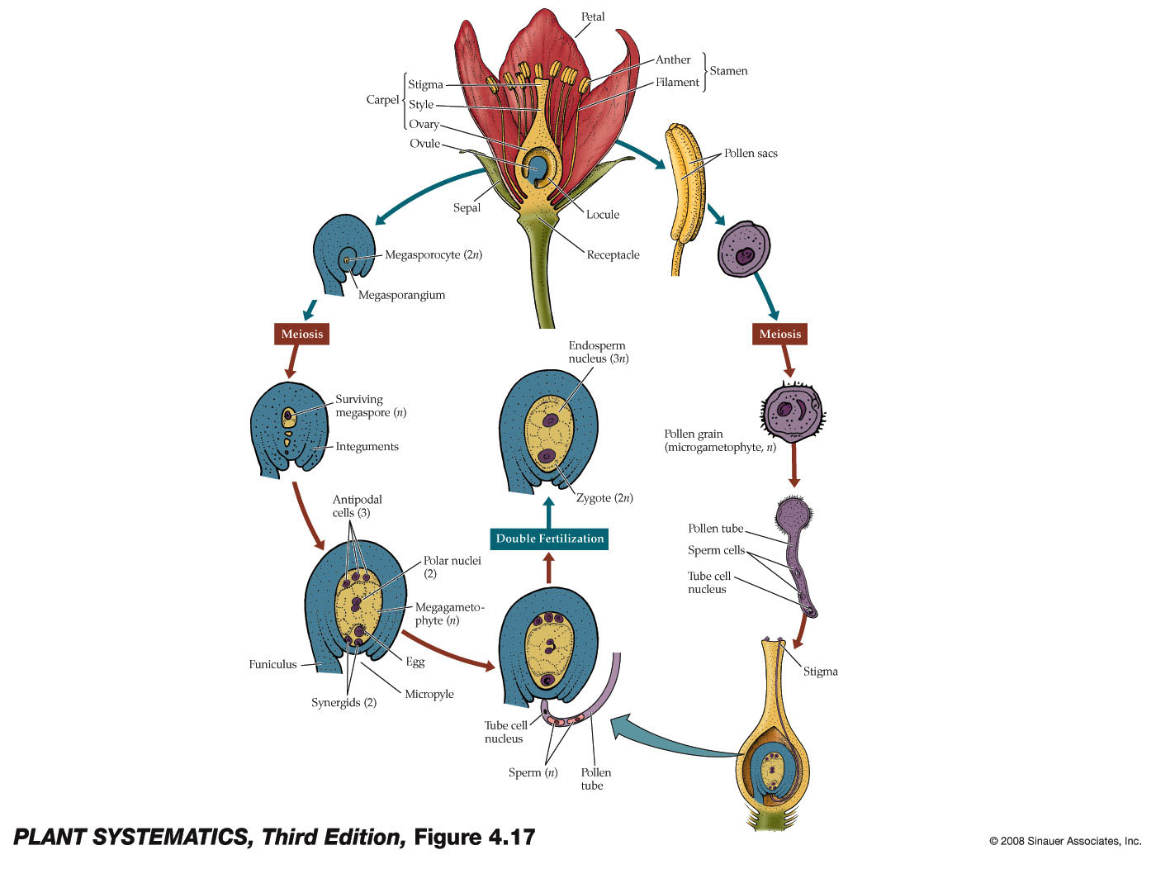
Add into this drawing the microsporocyte label, the microspores (n) and mitosis to form pollen.
Mitosis
4 microspores

Slide 14
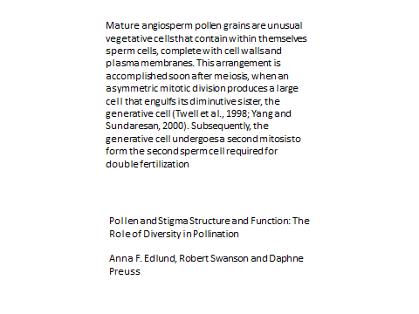

Slide 15
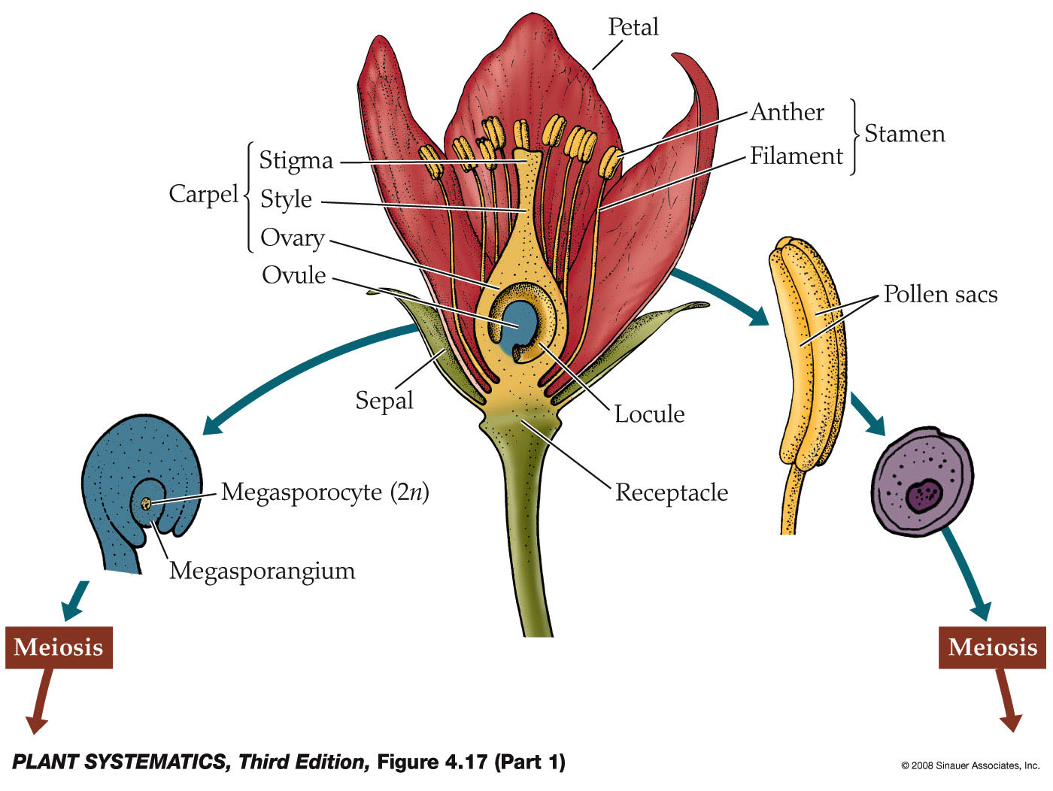
Alternation of Generations with further reduction in the Gametophyte
Diploid microsporocyte mother cell in Pollen sacs
(there are no gametophytes in this picture…)

Slide 16
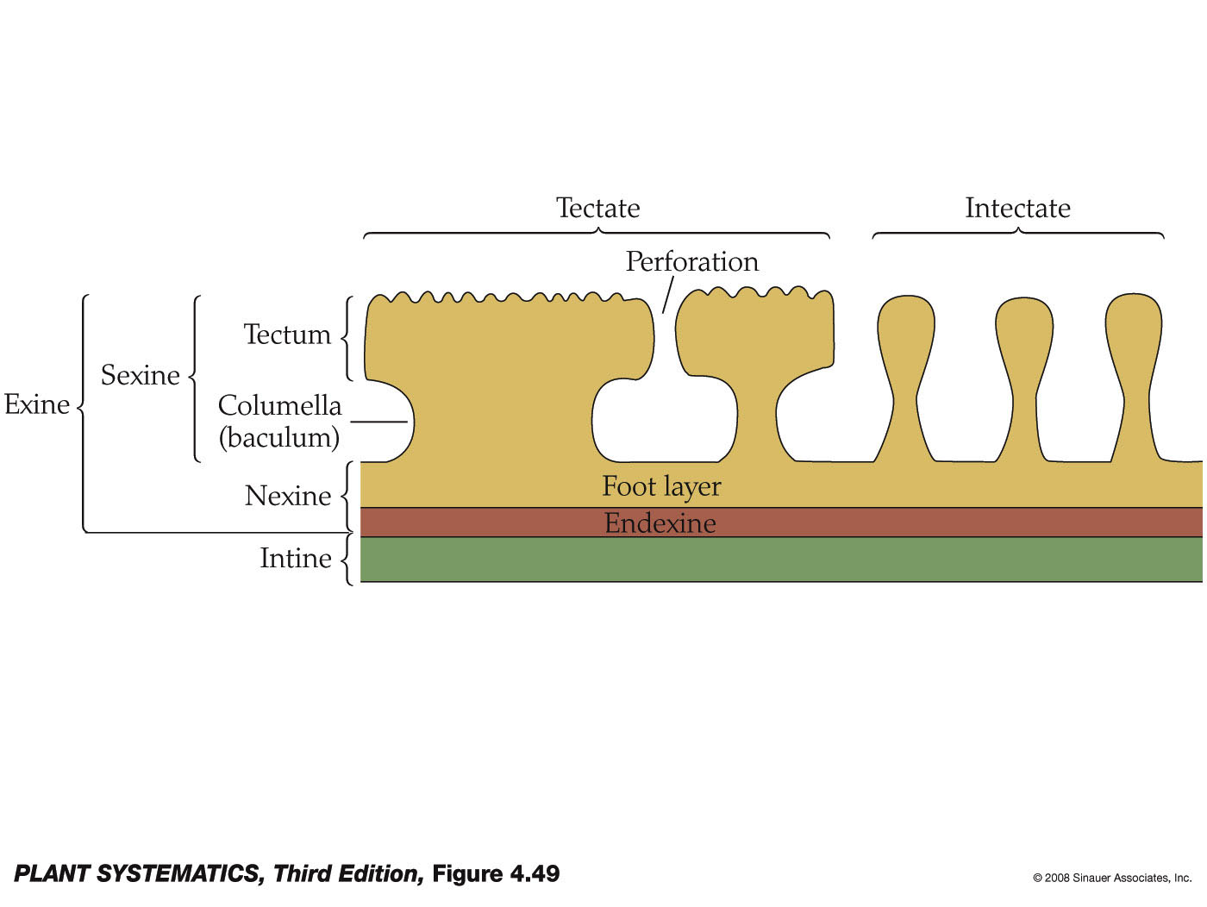
Cross Section of Typical Pollen Wall

Slide 17
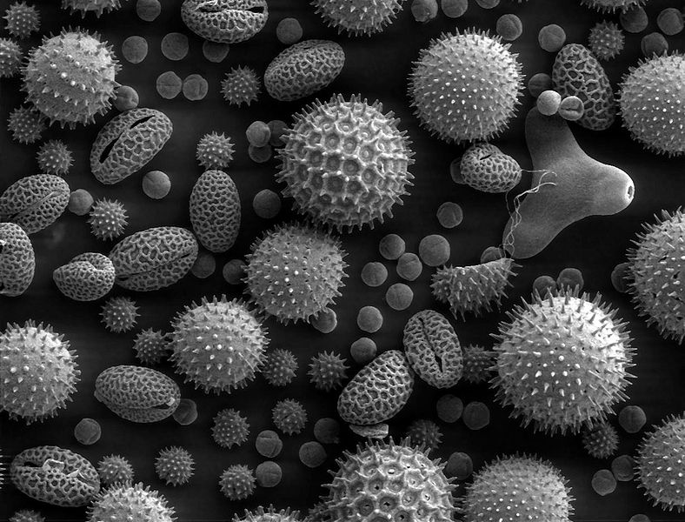
Pollen grain (pollen contains the mature male gametophyte)

Slide 18
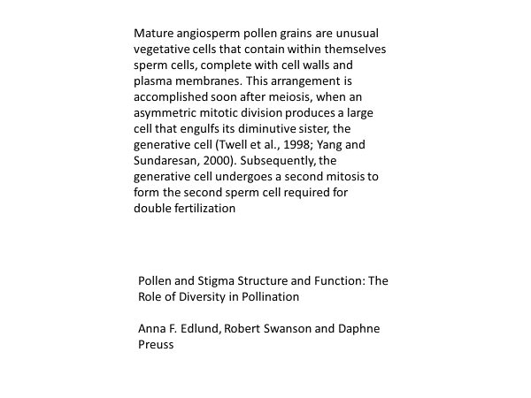
Pollen Grains

Slide 19
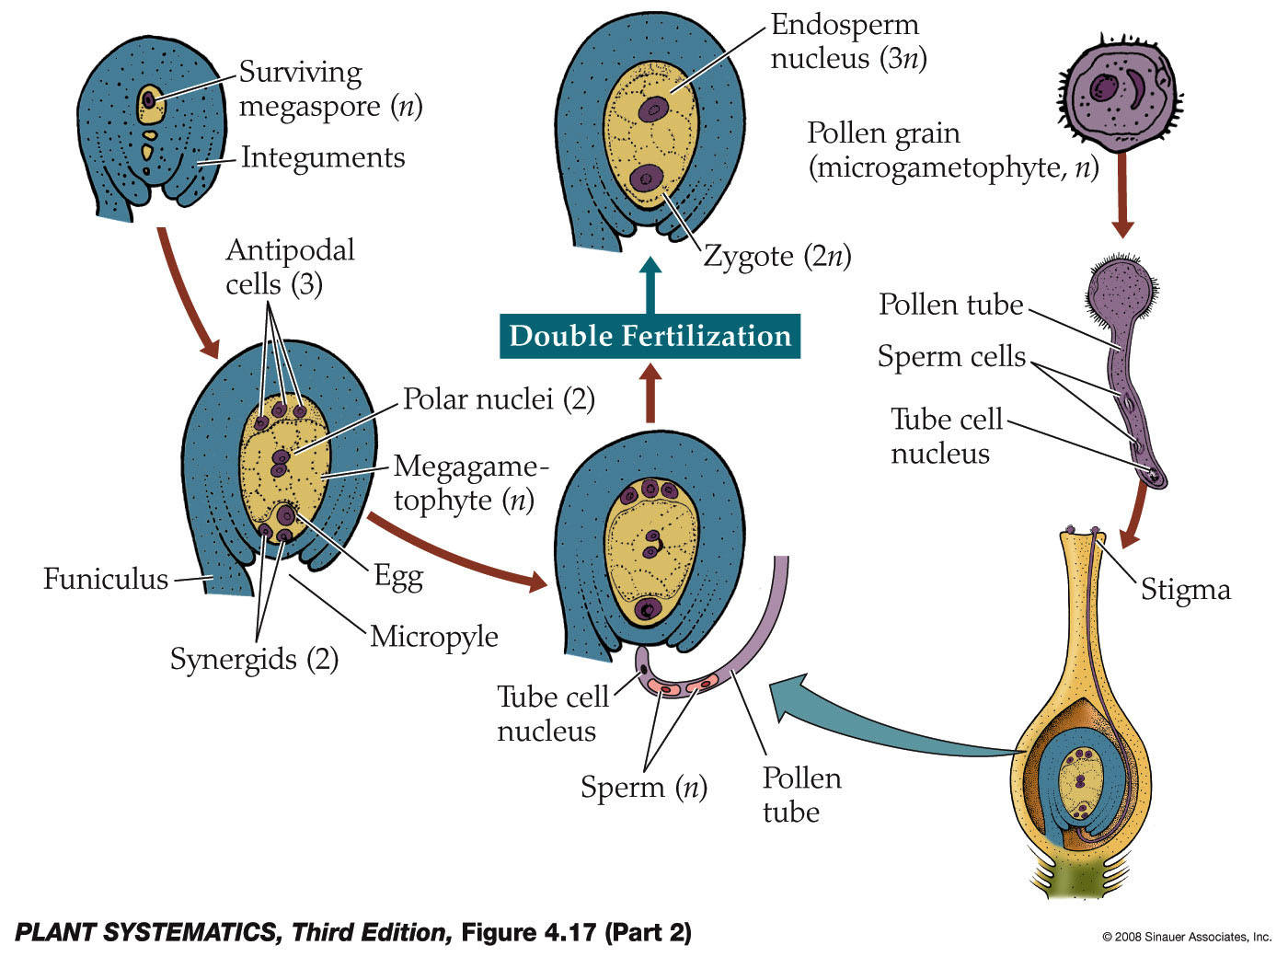
3 of 4 Megaspores Degenerate
Microgametophyte= male gametophyte
Megagametophyte= female gametophyte

Slide 20
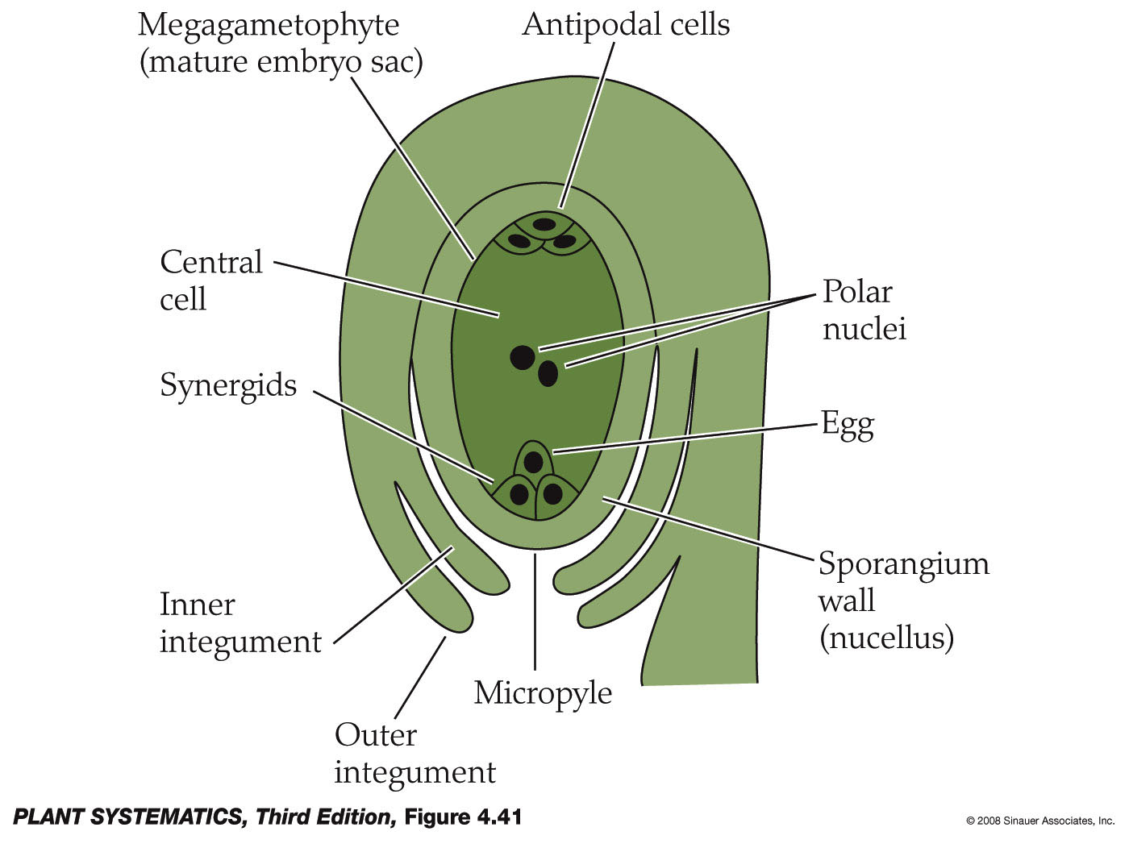
Ovule contains the female gametophyte
Develops into tegmen
Develops into testa

Slide 21
Outer & Inner Integuments
Become the seed coat
Testa and tegmen are derived from the outer and inner integuments, respectively.
Presumably these are protective coverings.
Q: Are the testa and tegmen cells haploid or diploid?

Slide 22
Double Fertilization
Mature female gametophyte consists of 8 nuclei in 7 cells (usually)

Slide 23
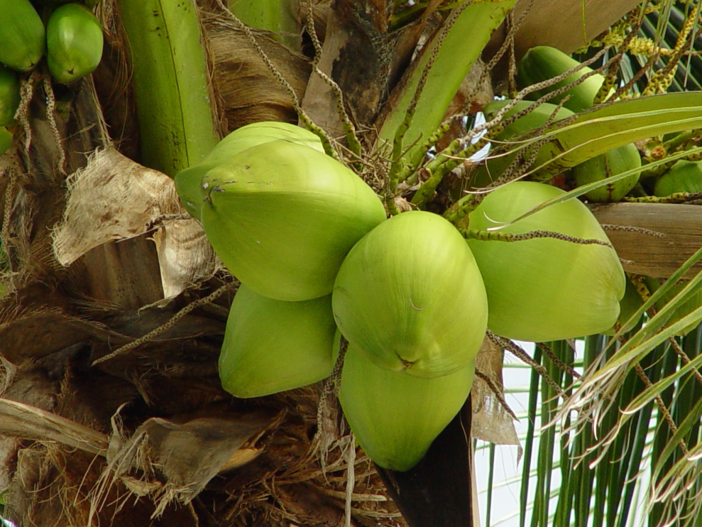

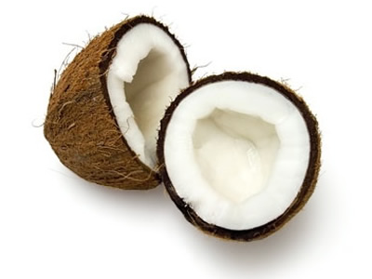
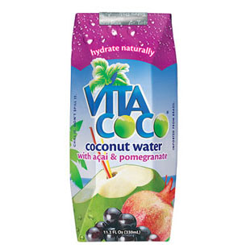
Nutritive Endosperm
Endosperm is triploid nutritive tissue for the developing embryo.

Slide 24
Angiosperm Synapomorphies
Seeds produced within a carpel with a stigmatic surface for pollen germination
Reduced female gametophyte– usually 8 nuclei in 7 cells
Double fertilization
Triploid nutritive tissue called “endosperm”

